Slide 1


Vecsim: Carrier-based, Privacy-Preserving Cellphone Contact Tracing
Avishek Mukherjee Department of Computer Science, Saginaw Valley State University | Yaoguang Zhong Department of Computer Science, Florida State University | Zhenghao Zhang Department of Computer Science, Florida State University
Tingting Zhao Department of Geography, Florida State University | Jinfeng Zhang Department of Statistics, Florida State University
Notes:
Good morning everyone! My name is Avishek. I am an Assistant Professor at Saginaw Valley State University, and I’m going to be talking be about our paper Vecsim, which is a carrier based privacy preserving cellphone contact tracing method. My co-authors are Dr. Zhenghao Zhang, Yoguang Zhong, Dr. Tingting Zhao and Dr. Jinfeng Zhang from Florida State University

Slide 2
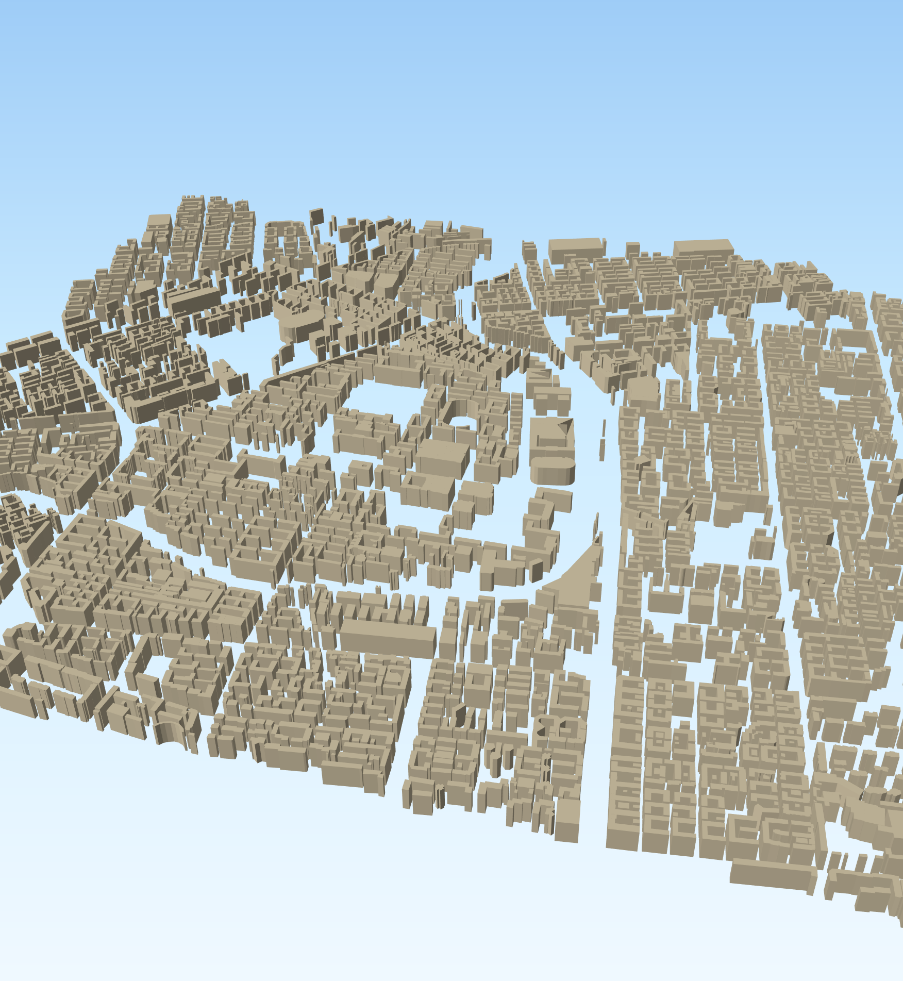
Vecsim: Carrier-based, Privacy-Preserving Cellphone Contact Tracing
A novel contact tracing method to track infectious diseases like COVID-19
Determines user proximity based on existing LTE log data collected by cellphone carriers.
Based on proximity detection rather than localization
No user involvement required and is easy to deploy.
96% accuracy in alerting cellphones within 50 meters of infected individual
Alerts less than 4.5% of cellphones beyond 150 meters
Notes:
So in this paper we propose Vecsim, a novel method to track infectious diseases like Covid-19, which has impacted the entire world. Our method is based on detecting user proximity by exploiting the rich LTE log data that is already being collected by cellphone carriers. It is important to note that our method is based on proximity detection and not localization which is a harder problem to solve. Further our system does not require any user involvement or intervention and is easy to deploy with the existing architecture. Our results show that Vecism can achieve 96% accuracy in tracing and alerting users who were within 50 meters of the contacted individual. Vecsim also only alerts less than 4.5% of users that were beyond 150 meters of the infected individual.

Slide 3
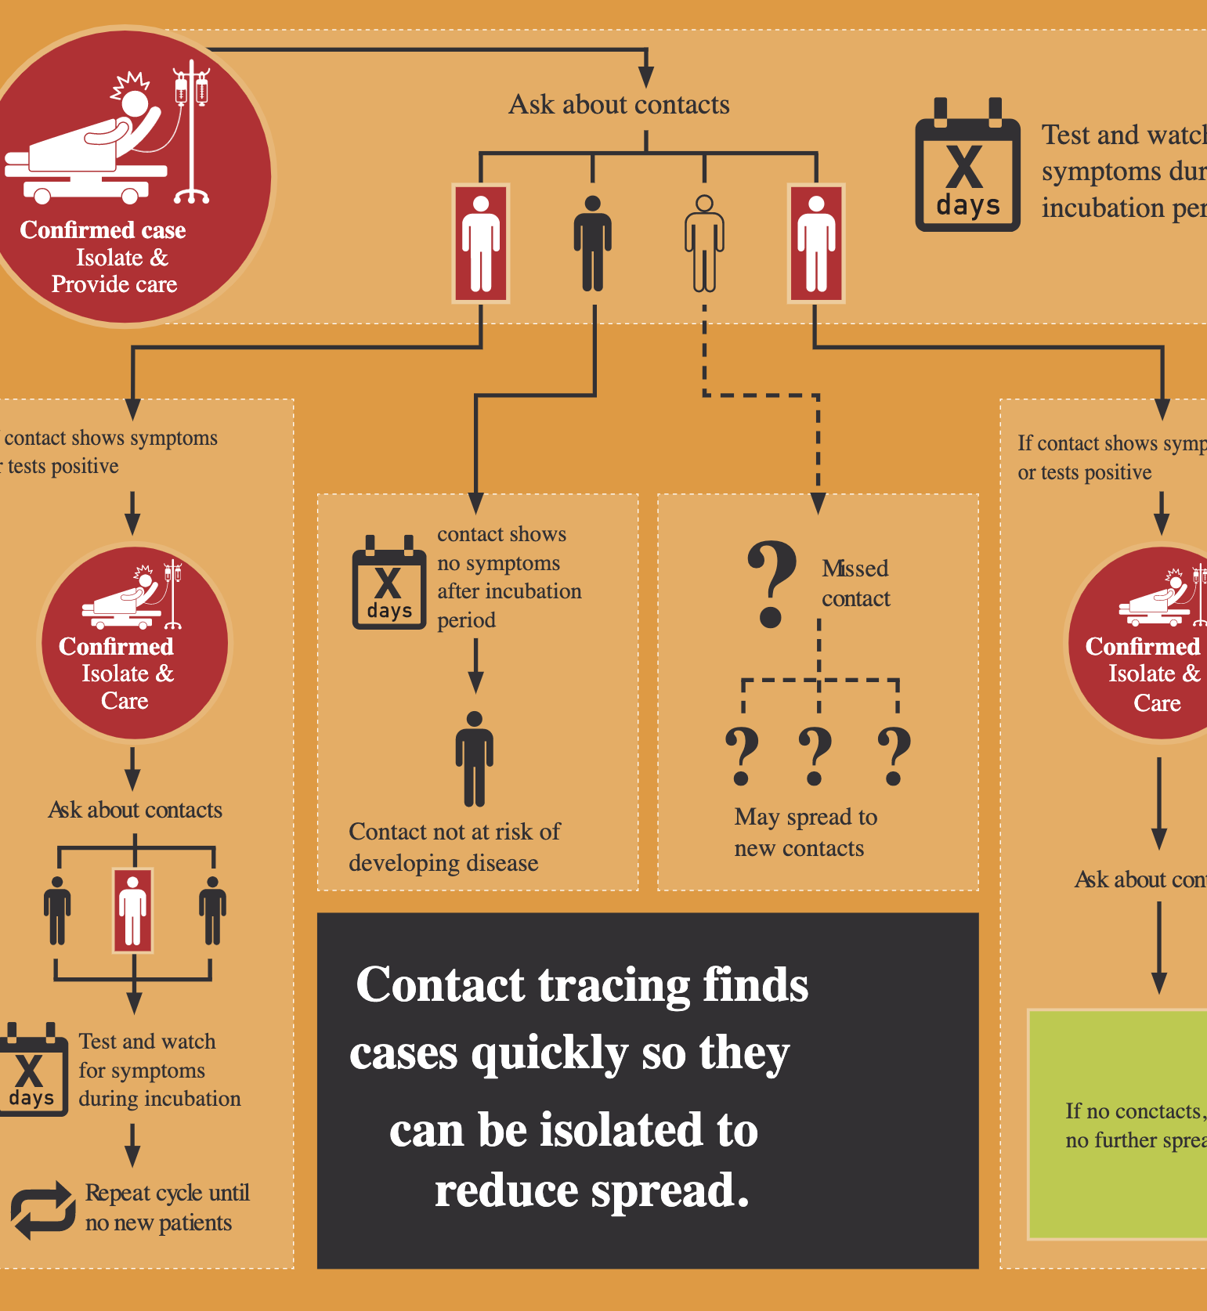
Contact Tracing
“A process to identify, monitor, and support individuals who may have been exposed to a person with a communicable disease, such as COVID-19.” – Center For Disease Control (CDC)
Slows the spread of infectious diseases.
Existing methods use a wide range of technologies to trace contacts that may have been exposed to an individual.
These include using GPS, Bluetooth, QR code scanning, wearable devices and more
Vecsim is different from all of these and does not rely on user location and preserves privacy.
Image Source : https://www.concordmonitor.com/What-We-Know-About-Coronavirus-Contact-Tracing-In-New-Hampshire-35789694
Notes:
Before talking about Vecsim, I want to start with a quick run down of the different contact tracing methods that are currently in use or have been proposed in an effort to distinguish Vecsim with these methods. First The Center for Disease Control defines Contact tracing as a process to identify, monitor, and support individuals who may have been exposed to a person with a communicable disease, such as COVID-19.
The primary purpose of doing contact tracing is to slow down infectious diseases by isolating affected individuals from other healthy people.

Slide 4
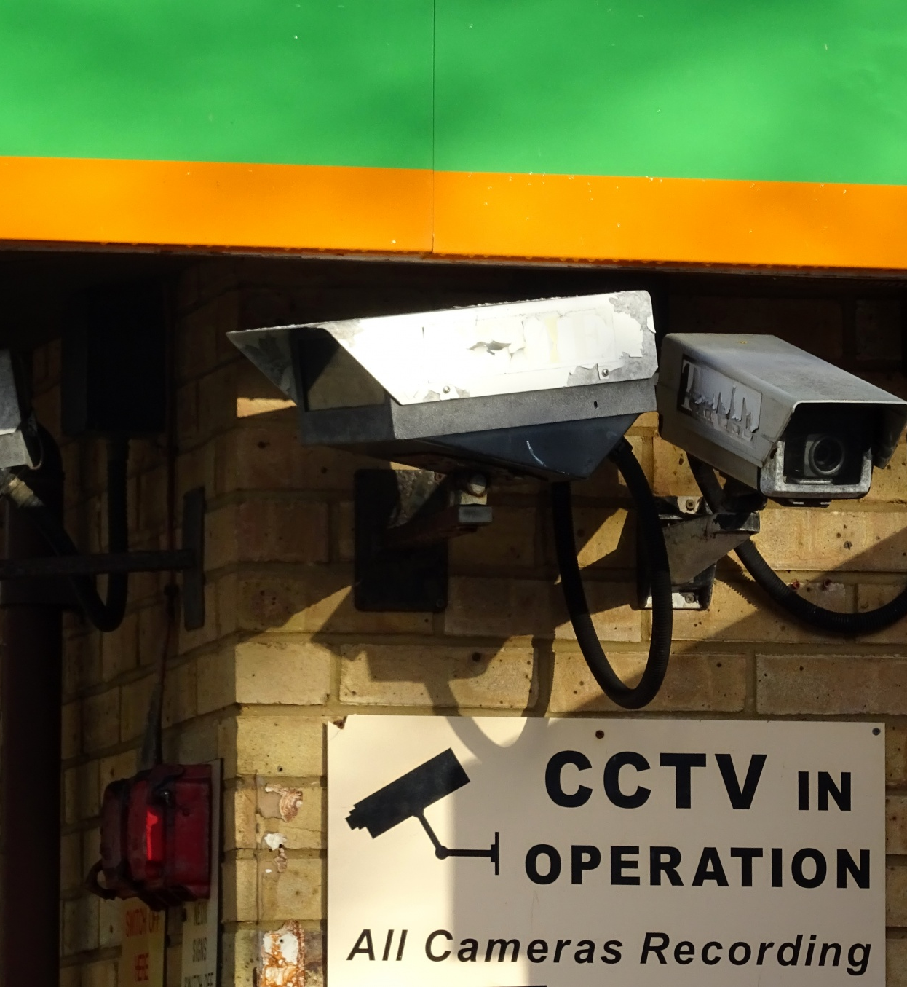
Related Work – Cellphone Signal
Widely used in South Korea during the COVID-19 pandemic
Uses a combination of user data like cellphone GPS, credit card transactions, CCTV footage, cellphone signal data
Determines the route an infected individual has taken and alerts others in the vicinity.
Privacy intrusive.
Vecsim does not require the GPS location and is privacy preserving
Image Source : https://www.publicdomainpictures.net/en/view-image.php?image=242115&picture=cctv-cameras-in-operation
Notes:
For example, during the current pandemic, South Korea implemented a contact-tracing method that uses a combination of GPS data from phones, credit card transactions, and CCTV footage in public areas to identify the path of an infected individual which can be considered privacy intrusive. Our method does not use any of these and is not privacy intrusive

Slide 5
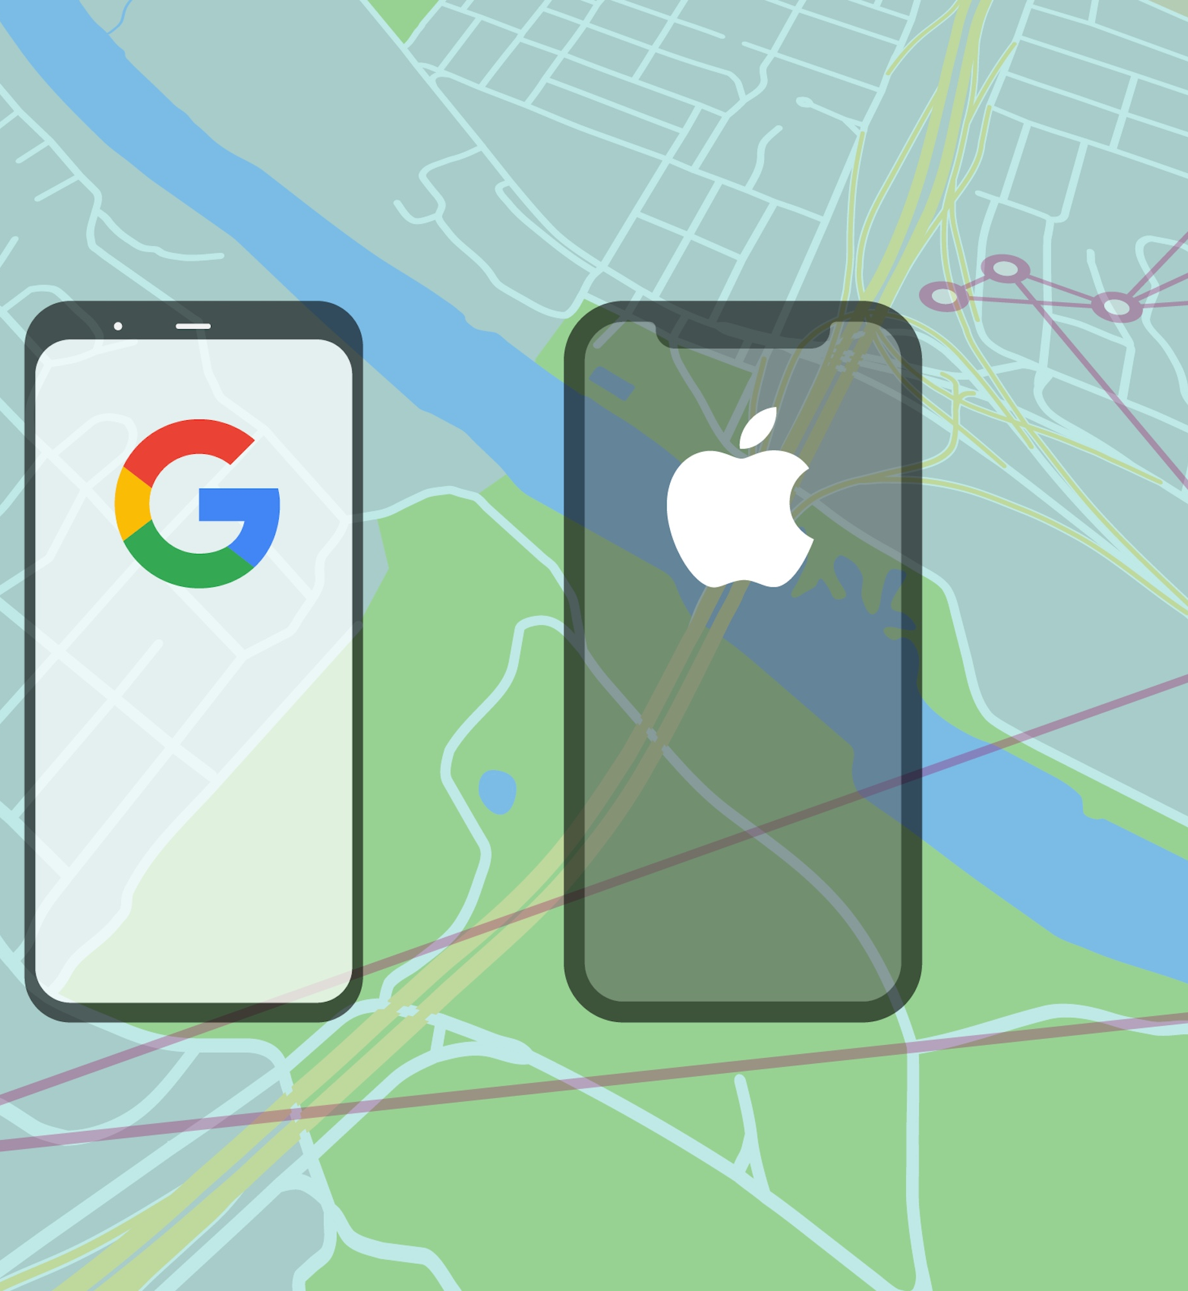
Related Work - Bluetooth
Requires users to download an application and to turn on the Bluetooth interface
When two phones are in close contact, the Bluetooth modules can discover each other.
Depends on the wide adoption of the application
Susceptible to a variety of network attacks.
VecSim does not require any additional actions from the user, and therefore will be much easier to deploy and may cover a larger population.
Image Source: https://techcrunch.com/2020/04/29/apple-and-google-release-first-seed-of-covid-19-exposure-notification-api-for-contact-tracing-app-developers/
Notes:
Another massive contact tracing effort that has been implemented jointly by apple and google relies on Bluetooth to identify users in close contact. The idea is that once users install and run these apps, they monitors other users with the same app that are in the vicinity and later alert these users if an infected individual was nearby. The main challenge here is to get enough users to actually download these apps, which is hard to do without some kind of government mandate These are methods are susceptible to various network attacks and there have been a number of papers outlining these vulnerabilities. it also requires user involvement, that is the user must download and install an application on their phone and allow that app access to the Bluetooth modules, for this to work. Vecism does not require any additional interaction from the user and is easier to deploy, because LTE log data is something that is already being collected by the cellphone carriers.

Slide 6
Other Contact Tracing methods
Social Networks
Relies on users and their peers to be active on these platforms
MAC address identification on Wi-Fi
Uses the signal strength to estimate proximity
Wearable devices
Users wear some sort of physical device that tracks the proximity with other users.
Notes:
Similar contact tracing methods have also been proposed that are based on
tracking user interactions through social networks, which would require the user and their peers to be active on these platforms which may not be a reasonable assumption
Using MAC address identification using Wi-Fi , whose coverage is less ubiquitous than LTE
And wearable devices, which require the user to wear a physical device that can monitor proximity to other users

Slide 7
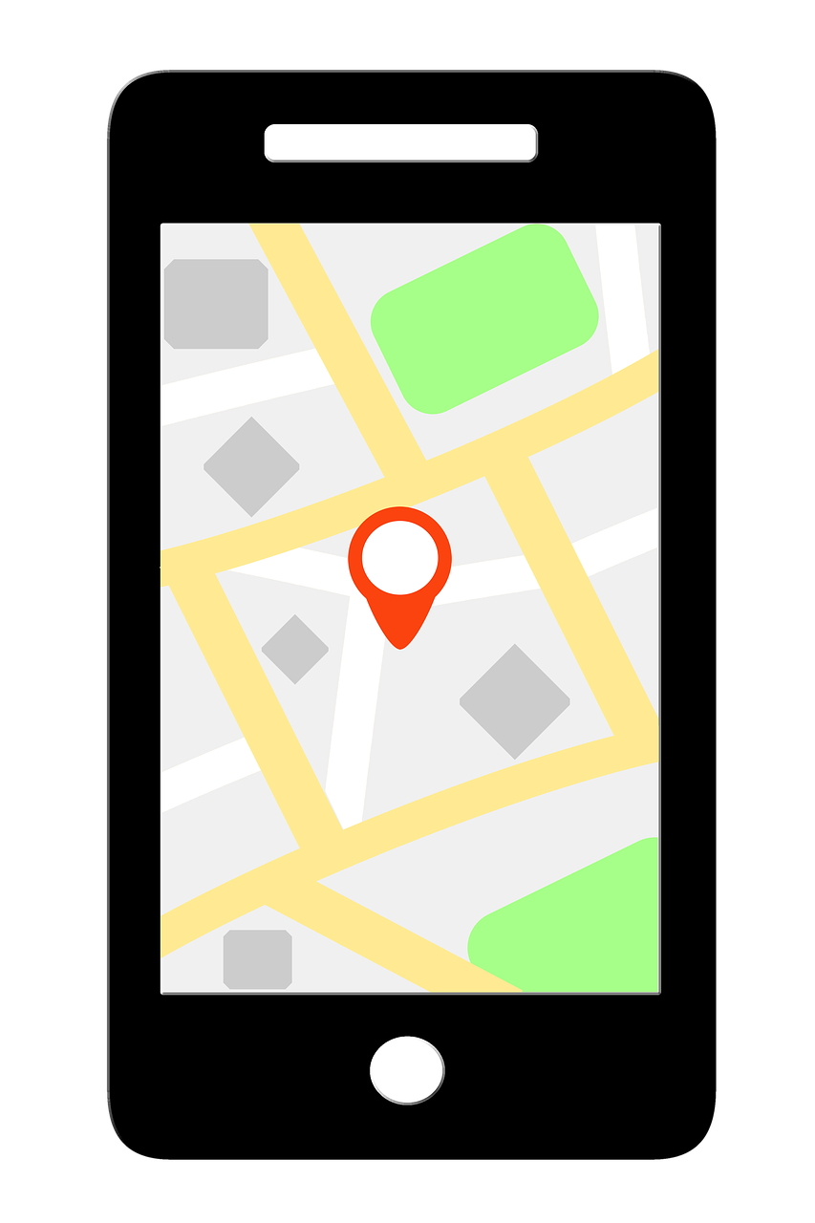
Related Work – Cellphone Localization
Localization based on cellphone signals is challenging!
Accuracy is typically with 0.75 square miles.
VecSim is different since it focuses on proximity detection
Localization also relies on labeled log data from cellphones that report their location.
VecSim relies on unlabeled log data which is more universally available
Image Source : https://www.needpix.com/photo/download/1146522/gps-locator-map-location-navigation-direction-travel-route-road
Notes:
We also want to note that our method is not based on Localization which is typically more challenging and is harder to obtain such data. Instead we focus on the proximity between 2 users rather their actual locations.

Slide 8
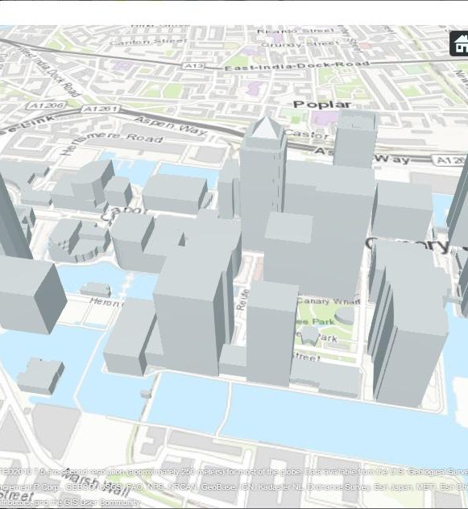
Related Work – Urban Field Signal Analysis
Ray Tracing and Signal propagation models have yielded encouraging results.
However they rely on the environment information to be sufficiently detailed.
VecSim does not require detailed information of the environment, like the material used in windows and walls of buildings
Instead only relies on the log data from the MRO records.
Image Source: https://www.mathworks.com/help/comm/ug/urban-channel-link-analysis-and-visualization-using-ray-tracing.html
Notes:
A final work that we want to note is urban signal field analysis that is done through ray tracing and signal propagation models. These methods are very useful, but ther require the environment information to be sufficiently detailed to map out an accurate signal model, For example, they need information like the material used in windows and walls of buildings. Vecsim is different from this since we only rely on the log data from the MRO records.

Slide 9

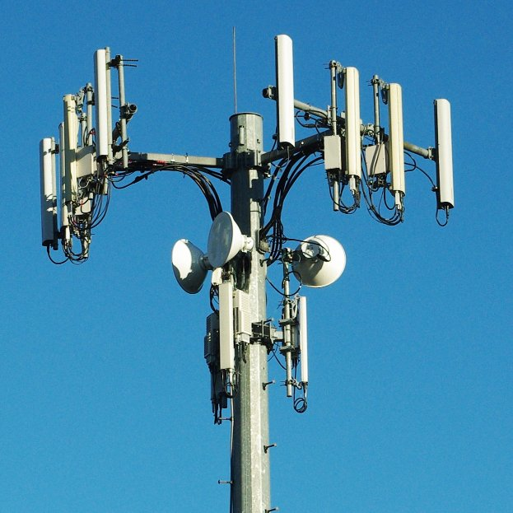
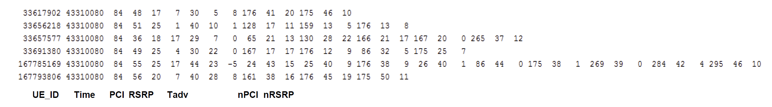
Background – LTE network
Cellphone carriers build towers to cover service areas.
Each tower typically mounts 3 base stations which are associated with an identifier called PCI.
Each base station continuously logs data to an MRO file which contains records of all connected cellphones.
Cellphones(UEs) report an MRO record every 5.12 seconds.
Image Source: https://www.prepaidphonenews.com/2014/09/what-phone-works-with-which-operator.html
Notes:
So in any LTE network cellphone carriers build towers to cover service areas. These towers typically mount 3 base stations which are associated with an identifier called PCI. Each of the stations continuously log data to an MRO file which contains records of all connected cellphones. Cellphones typically report an MRO record every 5.12 seconds.
The MRO record is a high dimensional vector which contains information like the UE_ID , Timestamp, the PCI of the tower it is connected to. In addition it reports some useful information that we use in our analysis. These are the ..

Slide 10

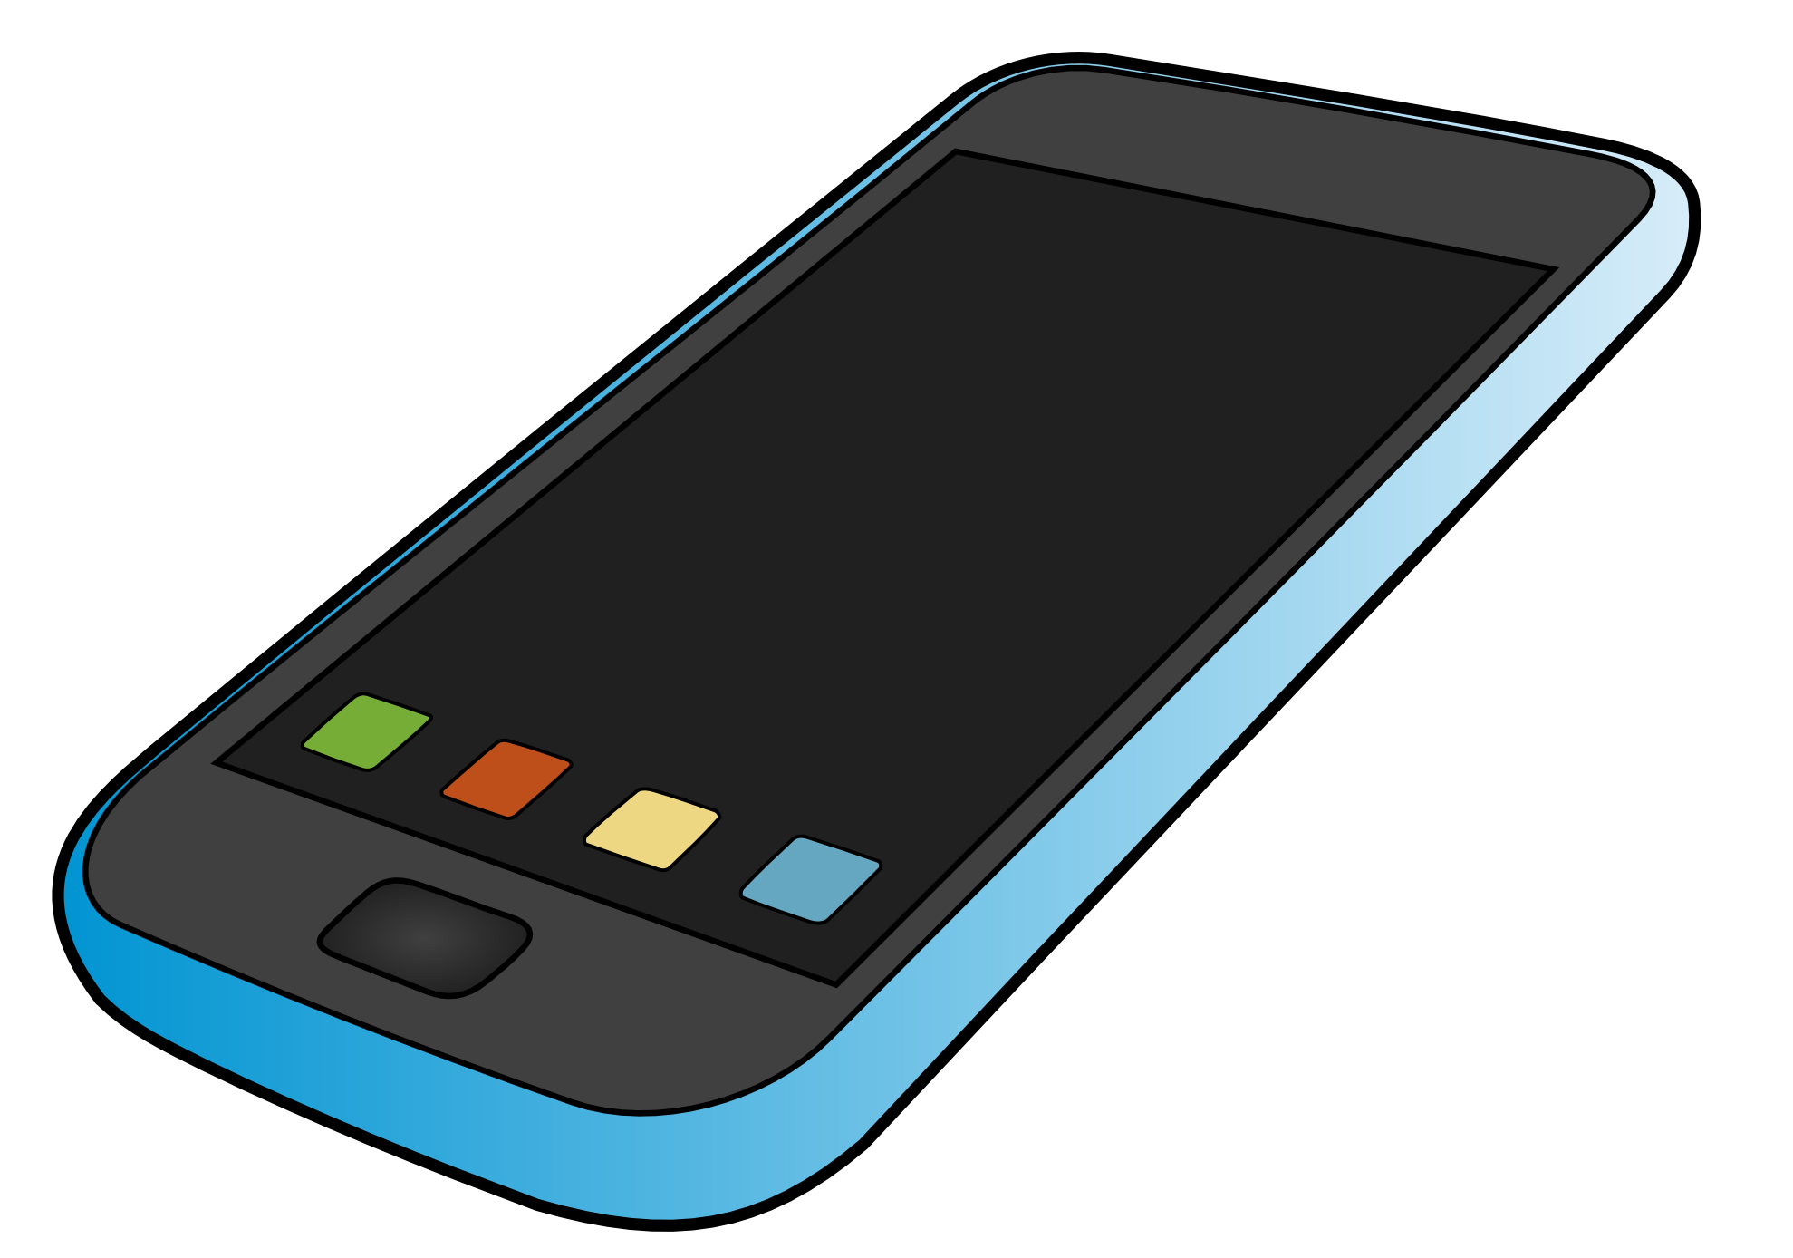
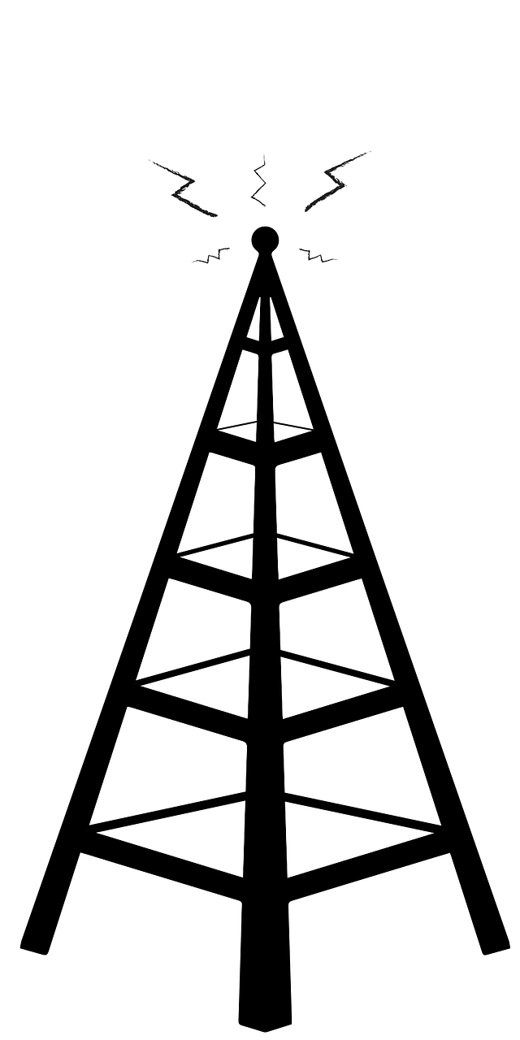

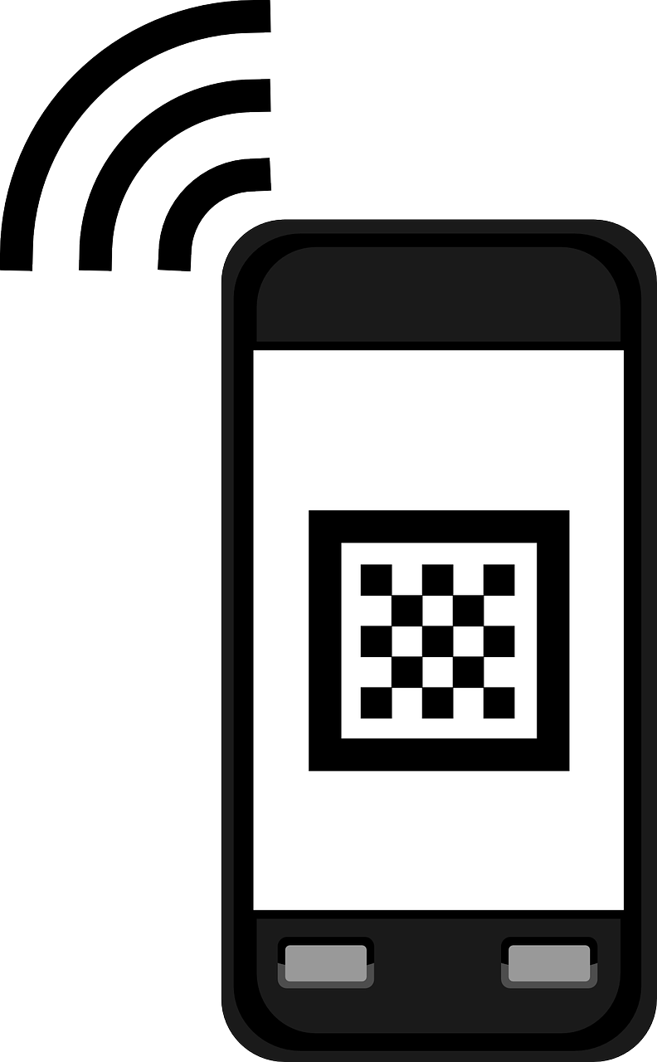
Tadv
Distance measurement
(Tadv)
Tadv(𝛄) - Measure of the length of the signal propagation path with a granularity of 78 meters. Typical range is [0, 10] in urban areas.
For line of sight paths , Tadv represents the distance between the device and the tower.
For Non-LOS paths, it is longer than the distance
In other words, Tadv represents the upper limit of the distance of the device and the tower.
Connected
tower
d1
d
d2
Tadv
Tadv = d1 + d2
Notes:
The Tadv which is a measure of the length of the signal propagation path, with a granularity of 78 meters. It typically ranges between 0 to 10 in urban areas.
It is important to note that for LOS paths the Tadv is a measure of the actual distance between the PCI and the UE, but for paths that undergo reflections, we can say that Tadv is the upper limit of the distance between the UE and the tower

Slide 11
Angle of Arrival
Angle of Arrival measurement
(AoA)
An MRO record is a high dimensional vector which includes
AoA(θ) - Angle of the signal from the cellphone observed at the base station. Range is [0,2𝜋]
Connected
tower
AoA(θ)
Notes:
The angle of arrival is another field we use in our analysis. It is basically the angle of the signal from the cellphone observed at the base station.

Slide 12
RSRP
Many power measurements
(RSRP)
An MRO record is a high dimensional vector which includes
RSRP(𝜔) - Signal strength of the base station the cellphone is connected to. Measured in dB.
Connected
tower
Notes:
The last 2 fields that we use in Vecsim are the RSRP which is the signal strength of the base station the cellphone is connected to and …

Slide 13
RSRP
Many power measurements
(RSRP)
An MRO record is a high dimensional vector which includes
RSRP(𝜔) - Signal strength of the base station the cellphone is connected to
nRSRP is the signal strength of the base station the cellphone can hear from, treated as RSRP in this work
Connected
tower
Notes:
The nRSRP which are the signal strength of the neighboring base stations that the cellphone can hear from.

Slide 14
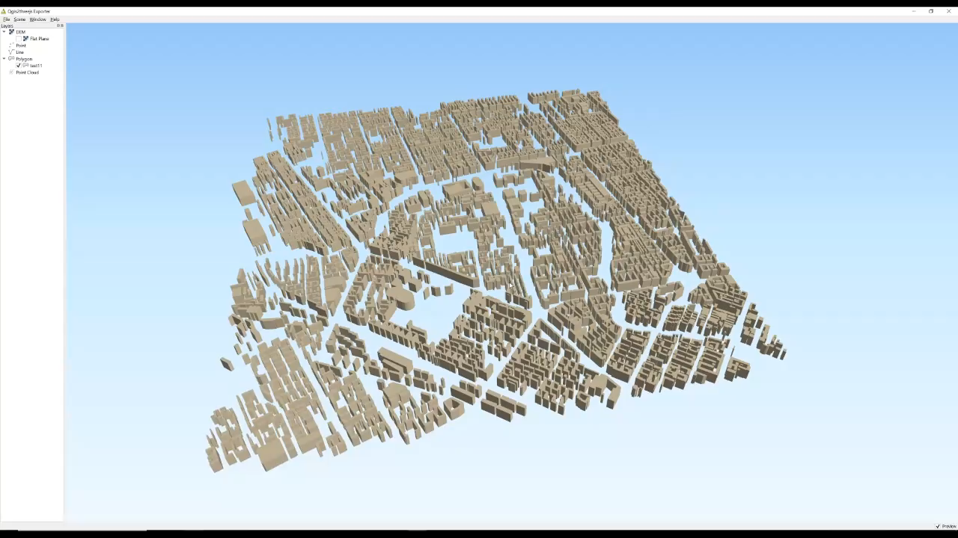
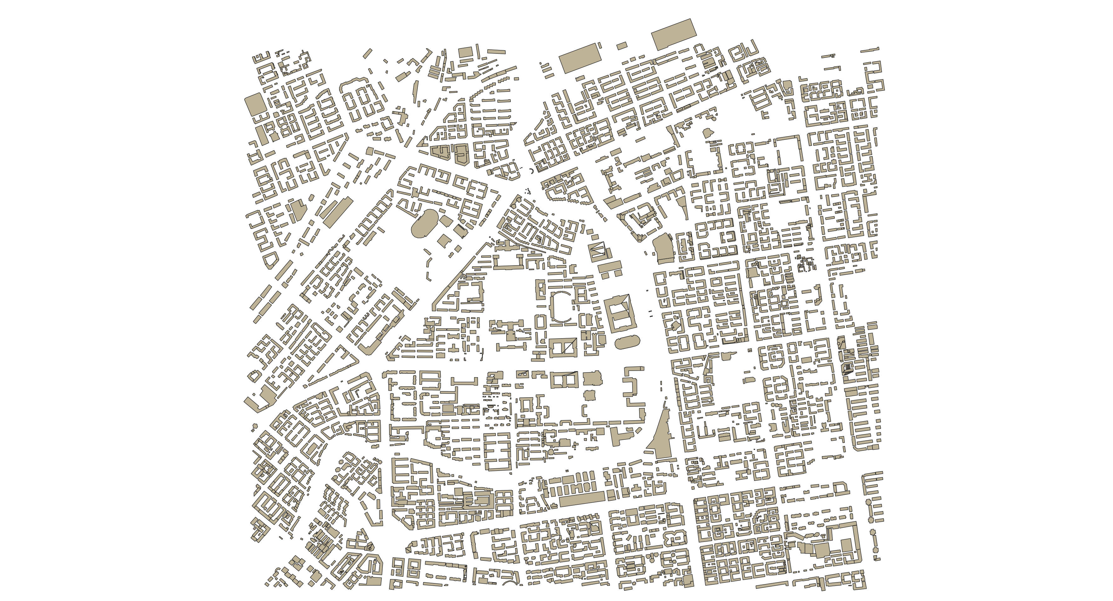
Data generation
A ray tracing program (Wireless Insite) was used to generate the signal field in a simulated 4km x 4km urban area.
Area contains 13 towers (39 base stations)
Notes:
We first used a ray tracing program to generate a signal field in a simulated 4km x 4km urban area. The animation playing on top is a render of what the area looks like in 3d and the bottom figure is a 3d view from the the top of our urban area,

Slide 15
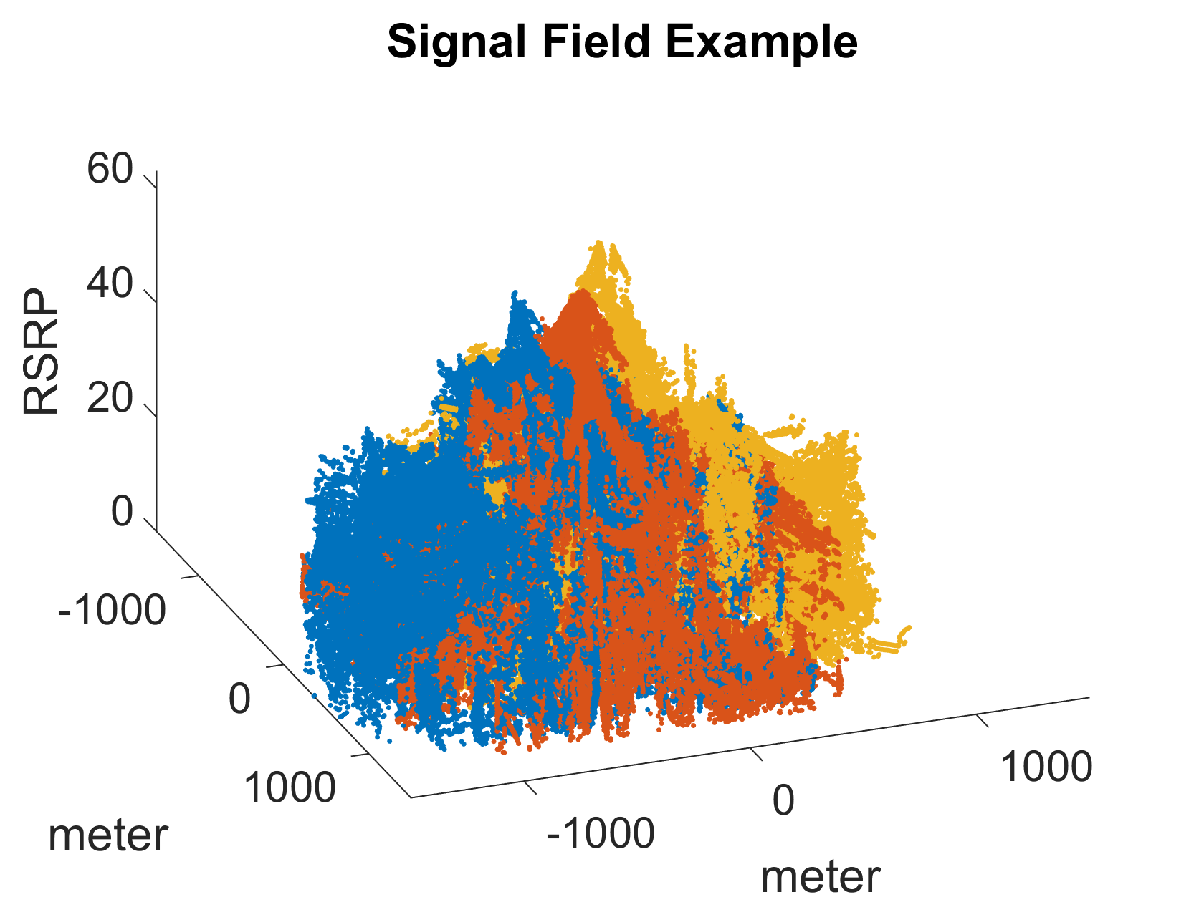
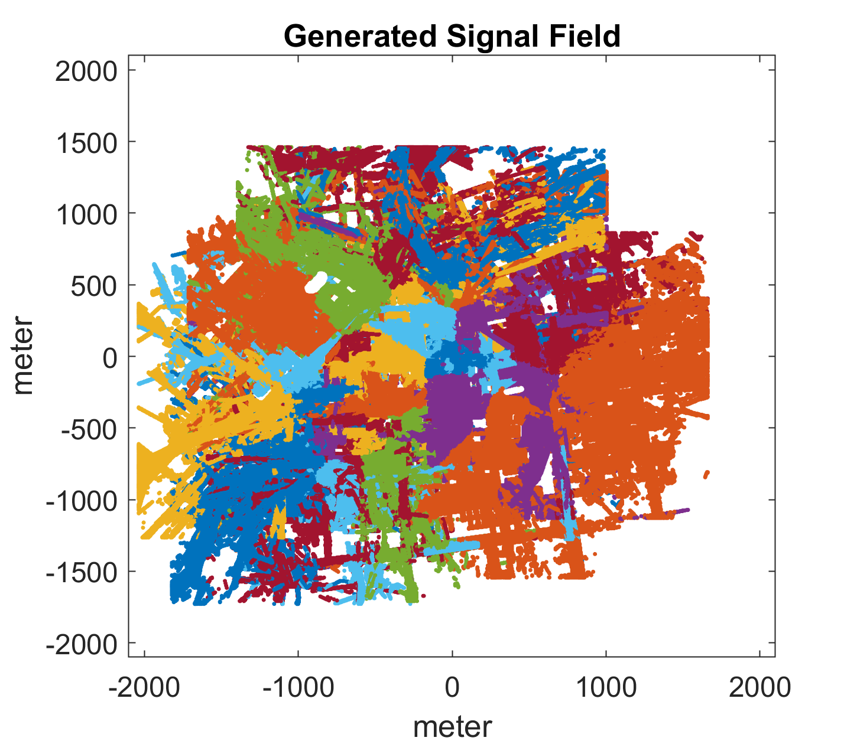
Data generation
We had only the cellphone tower locations in the area. The coverage of the area near the boundary is not clear.
We only simulate the signal field within 2km x 2km area centered at the base of each tower.
Notes:
Our signal field is generated from13 cellphone towers.
We note that since we do not know the cellphone coverage of the area near the boundaries which may include signals from other towers outside of our simulated area, we only consider the signal field with a 2kmx2km area centered at the base of every tower,

Slide 16

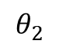
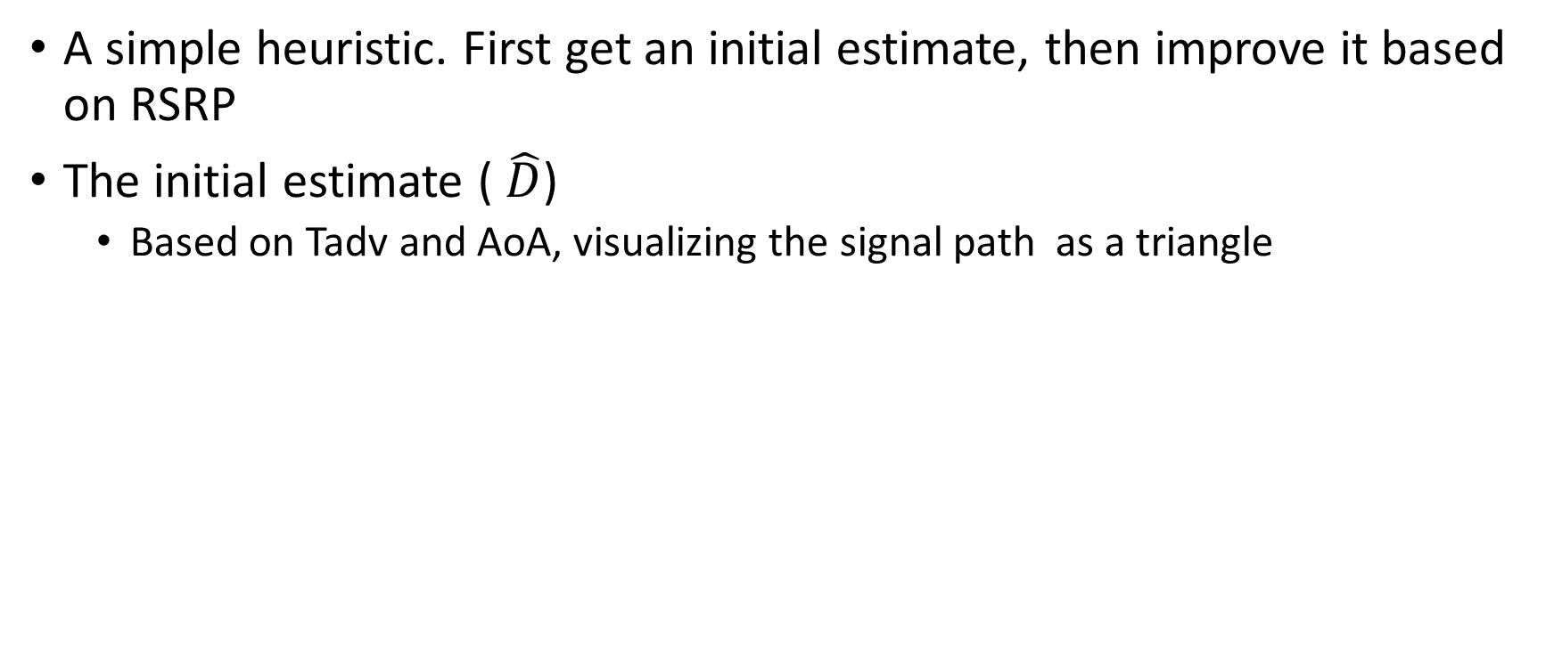
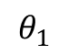
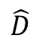
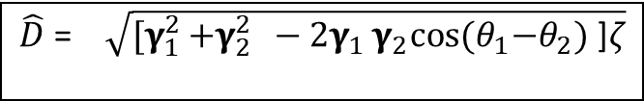
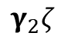
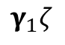
The Distance Estimation
A simple heuristic. First get an initial estimate, then improve it based on RSRP
The initial estimate ( $\hat{D}$)
Based on Tadv and AoA, visualizing the signal path as a triangle
$$θ_{2}$$
$\hat{D}$ =$\sqrt{{\text{[}\text{γ}}_{1}^{2 }+{\text{γ}}_{2}^{2 } −2{\text{γ}}_{1}{\text{γ}}_{2}cos{{(θ}_{1}\text{−}θ_{2})\text{ ]}\text{ζ}}}$
$$θ_{1}$$
$${\text{γ}}_{1}\text{ζ}$$
$${\text{γ}}_{2}\text{ζ}$$
$$\hat{D}$$
Notes:
Vecsim is based on proximity detection which relies on estimating the distance between 2 l;ocations by looking at their MRO records.
Our distance estimation is a core heuristic that we use to denote the distance between two MRO records. We start off with an initial estimate where we compute the distance by visualizing two cellphones connected to the same base station as the 3 edges of a triangle shown in orange, where the length of the top 2 sides is based on our TADV measurement and the base of the triangle is our initial distance estimate which can be computed using [ formula] where theta1 and theta2 are the measured AOAs in our MRO records

Slide 17
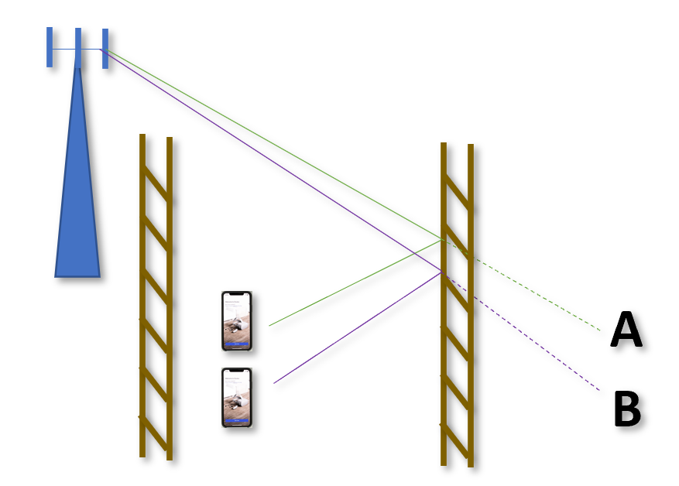

The Distance Estimation
A simple heuristic. First get an initial estimate, then improve it based on RSRP
The initial estimate
Based on Tadv and AoA, visualizing the signal path as a triangle
Interestingly, it works sometimes even when the path is not LOS.
For example, in this instance the distance between the mirrored points is the same as the actual distance between the cellphones.
This is better than using localization which may naively think the mirrored points are the actual cellphone locations.
$\hat{D}$ =$\sqrt{{\text{[}\text{γ}}_{1}^{2 }+{\text{γ}}_{2}^{2 } −2{\text{γ}}_{1}{\text{γ}}_{2}cos{{(θ}_{1}\text{−}θ_{2})\text{ ]}\text{ζ}}}$
Notes:
The interesting aspect of this initial measurement is that it sometimes provides a good starting point even when the signal propagation paths are not directly LOS paths. For example, in the figure shown here, the 2 cellphones receive the signal after reflection from a nearby building . Because we are only interested in the distance between the cellphones, our original equation will still work because the distance between the mirrored points is the same as the actual distance between the 2 cellphones.
This gives us a substantial advantage over localization methods, where it is possible to naively think the mirrored points are the actual locations.

Slide 18
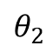
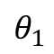
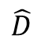

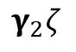
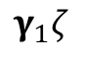
The Distance Estimation
$$θ_{2}$$
$${\text{γ}}_{1}\text{ζ}$$
$$θ_{1}$$
$${\text{γ}}_{2}\text{ζ}$$
The initial estimate
Is a good starting point but will likely deviate from the actual value in more complicated environments.
Additional adjustments are made based on the RSRP values using the Maximum Likelihood Principle.
$$\hat{D}$$
$\hat{D}$ =$\sqrt{{\text{[}\text{γ}}_{1}^{2 }+{\text{γ}}_{2}^{2 } −2{\text{γ}}_{1}{\text{γ}}_{2}cos{{(θ}_{1}\text{−}θ_{2})\text{ ]}\text{ζ}}}$
Notes:
While our initial estimate is good for LOS paths and some reflected paths, it will likely deviate from the actual value in more complicated environments with multiple reflections and other phenomenon. So we adjust our distance estimate based on our initial estimate which is still a good starting point and the RSRP values from nearby cell towers that are present in the MRO records using the maximum likelihood principle.

Slide 19
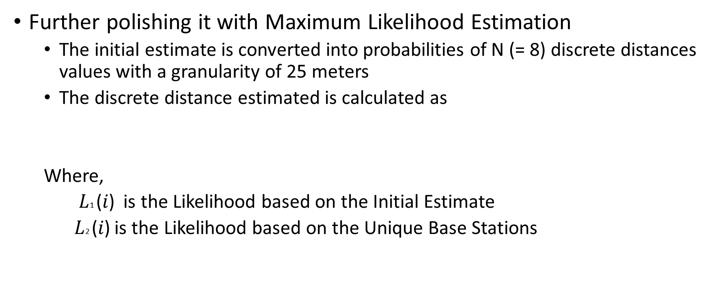
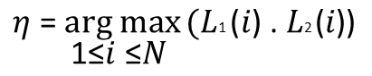
The Distance Estimation
Further polishing it with Maximum Likelihood Estimation
The initial estimate is converted into probabilities of N (= 8) discrete distances values with a granularity of 25 meters
The discrete distance estimated is calculated as
Where,
$\text{L}\text{1 }\text{(}\text{i}\text{) }$ is the Likelihood based on the Initial Estimate
$\text{L}\text{2 }\text{(}\text{i}\text{)}$ is the Likelihood based on the Unique Base Stations
$$\text{η} \text{=} \underset{\text{1}\text{≤}\text{i} \text{≤}\text{N} }{arg max}{\text{(}\text{L}\text{1 }\text{(}\text{i}\text{) }\text{. }\text{L}\text{2 }\text{(}\text{i}\text{)}\text{)} }$$
Notes:
To do this we first convert our initial estimate into a grid value with a granularity of 25 meters. We use 8 such distances starting from 25, 50 .. Upto 200, Distance estimates beyond 200m are treated as 200m for the purposes of contact tracing. Our final discrete distance estimate is calculated as the largest product of 2 likelihood functions for each of the 8 discrete distances. The 2 likelihood functions we use are the maximum likelihood based on the initial discrete estimate and the ML based on the RSRP of unique base stations.

Slide 20
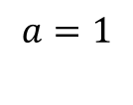
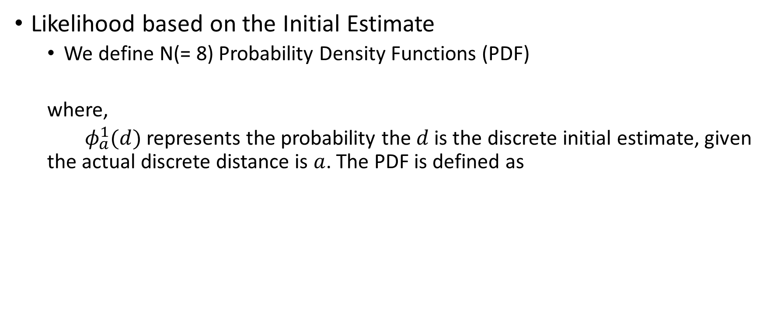
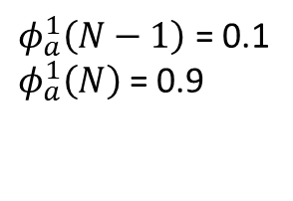
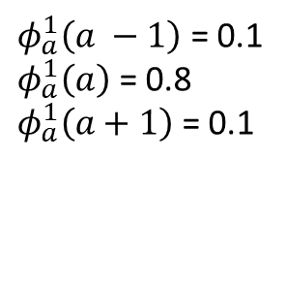
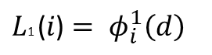
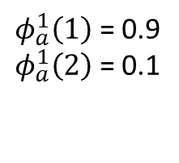
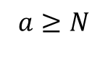
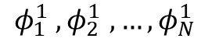
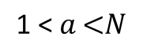
The Distance Estimation
Likelihood based on the Initial Estimate
We define N(= 8) Probability Density Functions (PDF)
where,
$φ_{a}^{1}(d)$ represents the probability the $d$ is the discrete initial estimate, given the actual discrete distance is $a$. The PDF is defined as
$$φ_{1}^{1} ,φ_{2 }^{1}, …,φ_{N}^{1}$$
$φ_{a}^{1}\left(a −1\right)$ = 0.1
$φ_{a}^{1}\left(a\right)$ = 0.8
$φ_{a}^{1}\left(a+1\right)$ = 0.1
$φ_{a}^{1}\left(1\right)$ = 0.9
$φ_{a}^{1}\left(2\right)$ = 0.1
$φ_{a}^{1}\left(N−1\right)$ = 0.1
$φ_{a}^{1}\left(N\right)$ = 0.9
$$a=1$$
$$\text{1}\text{ <} a\text{ <}\text{N}$$
$$a≥N$$
$\text{L}\text{1 }\text{(}\text{i}\text{)}= φ_{i}^{1}\left(d\right)$
Notes:
Our first likelihood is based on the discrete estimate. We basically define a set of 8 PDFs . The idea is that given the actual discrete distance a, we find the probability of our discrete initial estimate.
For example, if the actual discrete distance is 5, and our initial estimate is also 5, we use a probability of 0.8 , to indicate that our estimate is likely to be correct. On the other hand if we get an initial estimate of 6, when the actual distance was 5, then we can say use a probability value of 0.1 meaning it is less likely, but possible.
This is done for all 8 PDFs.

Slide 21
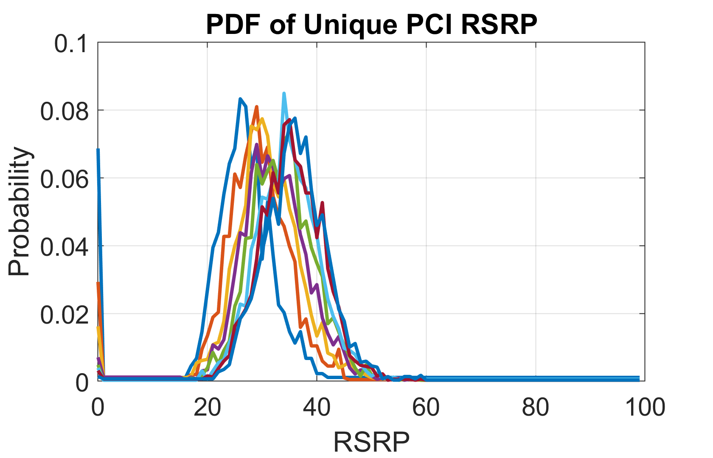
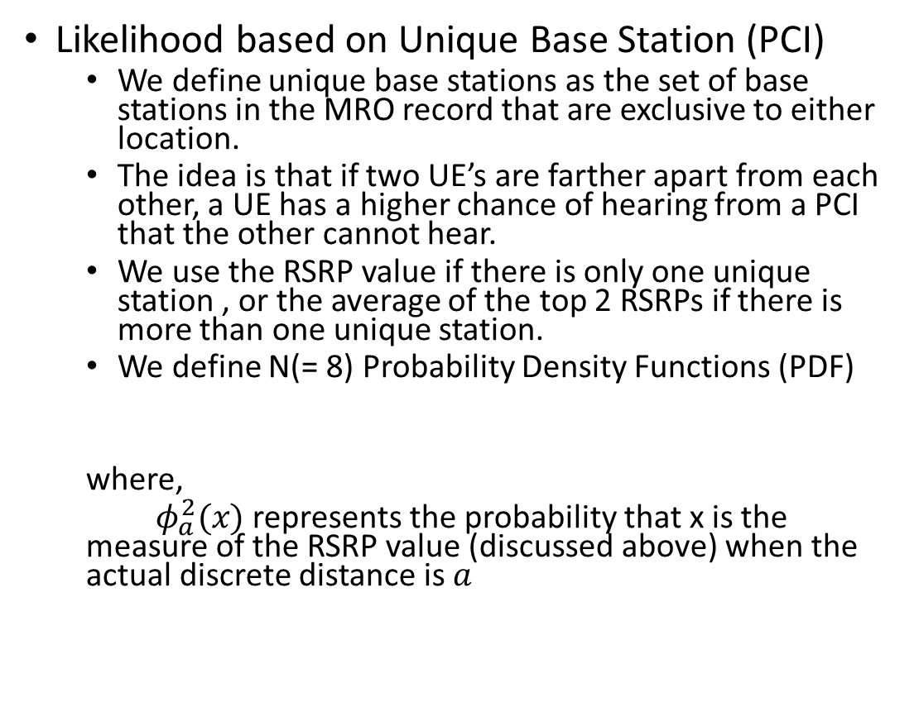
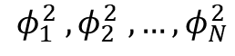
The Distance Estimation
Likelihood based on Unique Base Station (PCI)
We define unique base stations as the set of base stations in the MRO record that are exclusive to either location.
The idea is that if two UE’s are farther apart from each other, a UE has a higher chance of hearing from a PCI that the other cannot hear.
We use the RSRP value if there is only one unique station , or the average of the top 2 RSRPs if there is more than one unique station.
We define N(= 8) Probability Density Functions (PDF)
where,
$φ_{a}^{2}(x)$ represents the probability that x is the measure of the RSRP value (discussed above) when the actual discrete distance is $a$
$$φ_{1}^{2} ,φ_{2 }^{2}, …,φ_{N}^{2}$$
Notes:
Our second Likelihood estimate is based on the PCI of the unique base stations. We define a unique base station as the base station which is unique to either of the 2 MRO records. The idea is that if the 2 records are far apart, there is a greater chance that a UE will record the RSRP of base station that the other UE cannot hear.
Given the actual discrete distance a, we determine the probability of the measured RSRP value. For example, in the figure on the right the left most blue line are the PDF of the RSRP value when the discrete distance is 1 or 25 meters.. It peaks at about 25 and goes to 0 beyond 40, So if our observed RSRP val;ue of the unique base station is around 40, we can say it is highly unlikely that these 2 stations are within 25 meters of each other.
So we use the product of these 2 likelihood functions to find the best distance estimate from 1 – 8 and use that as our final discrete distance estimate

Slide 22
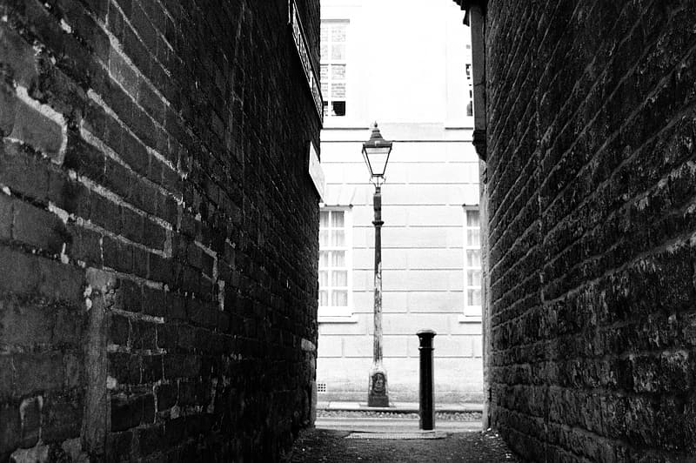
Signal Discontinuity
In an ideal case, the signal field should be continuous, and our distance estimation should hold for all pairs of locations
However this assumption does not hold in cities where large buildings can block and reflect signals.
For example, the signal may undergo a large change when emerging from an alley onto a major road.
Vecsim tackles this problem by learning the discontinuity of the signal field using the massive LTE log data available.
Image Source: http://absfreepic.com/free-photos/download/alleyway-in-black-white-photo-6016x4000_54807.html
Notes:
Our proposed measurements work well in an ideal scenario when the signal field is continuous, but this assumption does not hold in cities where large buildings and can block and reflect signals. For example, the signal may undergo a large change when emerginf form a small alley onto a major road. We tackle this problem by learning the discontinuity of the signal field using the existing LTE log data.

Slide 23
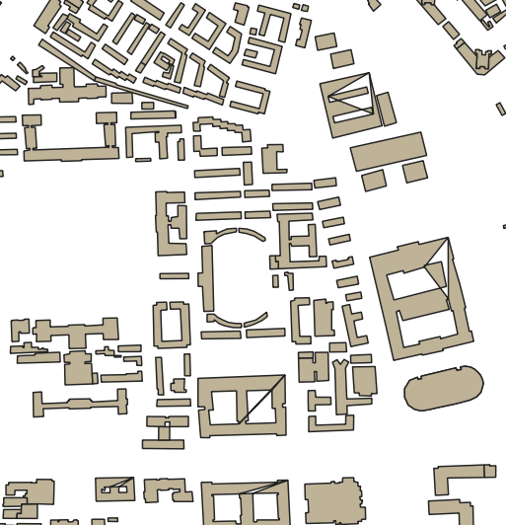
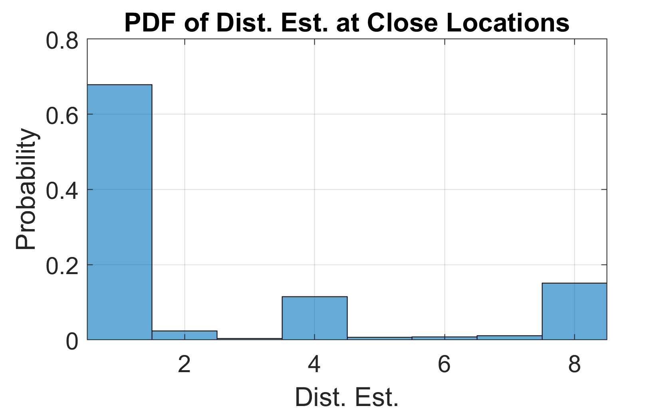
Discontinuity Pair
If 2 locations A and B are within 25m of each other and their discrete distance estimate 𝜉 (𝑅𝐴, 𝑅𝐵) > 4, then A and B are called a discontinuity pair.
We check every such point and their neighbors in the focus area to identify all such discontinuous pairs.
The fraction of discontinuous pairs are significant!
Notes:
To learn the discontinuity in the signal, We first define the term discontinuity pair. …

Slide 24
Discontinuity Pair
If 2 locations A and B are within 25m of each other and their discrete distance estimate 𝜉 (𝑅𝐴, 𝑅𝐵) > 4, then A and B are called a discontinuity pair.
We check every such point and their neighbors in the focus area to identify all such discontinuous pairs.
The fraction of discontinuous pairs are significant!
A
---
B
Notes:
For example, if we zoom in on the map the points A and B shown here are a classic example of a discontinuous pair, where the individual emerged from between 2 building onto a roadway.
if 2 locations A and B are within 25m of each other and their discreate distance estimate is larger than 4, we define A and B as a discontinuity pair

Slide 25
Discontinuity Pair
If 2 locations A and B are within 25m of each other and their discrete distance estimate 𝜉 (𝑅𝐴, 𝑅𝐵) > 4, then A and B are called a discontinuity pair.
We check every such point and their neighbors in the focus area to identify all such discontinuous pairs.
The fraction of discontinuous pairs are significant!
Notes:
To analyze the discontuity field, We chose a focus area shown here and checked every point with their immediate neighbors to identify all such pairs. What we found was that the fraction of discontinuous pair were actually significant, and would affect our overall estimation accuracy.

Slide 26
Learning the Discontinuity Pair Database
The discontinuity pairs can be learned from the massive MRO data, over time.
The key idea is that if the path of the user visits a discontinuity pair (𝐴, 𝐵), the MRO records reported at 𝐴 and 𝐵 will show high difference but will appear within a few timestamps to each other.
Thus, given any 2 MRO records (𝑅𝐴 , 𝑅𝐵) reported by the same cellphone with 10 timestamps of each other, add the pair of MRO records to a Discontinuity Pair Database (DPD) if 𝜉 (𝑅𝐴, 𝑅𝐵) > 4
Notes:
We quickly realized that even though such pairs were large, it can be learned over time using the MRO log data and logged to a database for lookups.
The key idea is that when a person is walking and their path visits a discontinuity pairs, the MRO records located at A and B will show a large difference but will be only a few timestamps of each other.
Thus given any 2 MRO records which are within 10 timestamps of each other and has distance estimate larger than 4, we add them to a discontinuity pair database, that we can use for lookups when doing contact tracing.

Slide 27
Compressing the DPD
Obviously, as more data is collected, the size of our database will grow.
To limit the size, we use a simple compression technique
The key idea is that if a candidate pair (𝑅𝐴 , 𝑅𝐵) is found, we first check the DPD if another pair (𝑅𝐴’ , 𝑅𝐵’) that is similar to (𝑅𝐴 , 𝑅𝐵)
To be more specific, the pair (𝑅𝐴 , 𝑅𝐵) is discarded if 𝜉 (𝑅𝐴, 𝑅𝐴’ ) <= 1 and 𝜉 (𝑅B, 𝑅B’ ) <= 1 , otherwise it is added.
A
B
𝜉 <= 1
𝜉 <= 1
B’
A’
Notes:
An obvious challenge is building this database was that as more and more data is logged, the size will continue to grow. To limit the size, we implemented a simple compression technique.
For example in the figure here A and B form a discontinuity pair, A’ and B’ also form a discontuity pair.
So the key idea is that if we find a candidate pair RA and RB are found where RA and RB represent the MRO records at locations A and B, we first check the database to see if another record RA’ and RB’ exist which are very similar to RA and RB.
Toi be more specific we find the discrete distance estimate between RA and RA’ . If these distance estimates are close, then we discard A and B, since A’ and B’ is already a good representation of this discontinuity.
If no such pair is found, then we add RA and RB in our discontuity pair database

Slide 28
Random Walk Simulation Study
To test the effectiveness of DPD, we simulate random walks in our focus area
We use 4m x 4m grid points
A user starting at location (𝑥,𝑦), can walk to any of the grid points in 4 directions (𝑥 + 1,𝑦), (𝑥,𝑦 + 1), (𝑥 − 1,𝑦), and (𝑥,𝑦 − 1)
(𝑥,𝑦)
Notes:
To test the effectiveness of our discontinuity database, we ran a simulated random walk study. Using 4m by 4m grid points, we simulate a user free to walk in 4 directions in our focus area.
So we start off with a random location which has a signal measurement as shown here ..

Slide 29
Random Walk Simulation Study
Initially a random quadrant is chosen as the main walking direction
For example, if a user chooses quadrant 1, the possible directions are (𝑥 + 1,𝑦) or (𝑥,𝑦+1).
This continues until either 100 steps are reached or the walk terminates when both directions hit a wall i.e. a point with no service.
(𝑥,𝑦+1)
Notes:
Initially the user chooses a random quadrant which is the main walking direction. For example in this case the user chooses 1, then at each step the user can either go right or go up based on a random generator. [keep changing slides]

Slide 30
Random Walk Simulation Study
Initially a random quadrant is chosen as the main walking direction
For example, if a user chooses quadrant 1, the possible directions are (𝑥 + 1,𝑦) or (𝑥,𝑦+1).
This continues until either 100 steps are reached or the walk terminates when both directions hit a wall i.e. a point with no service.
(𝑥+1,𝑦+1)

Slide 31
Random Walk Simulation Study
Initially a random quadrant is chosen as the main walking direction
For example, if a user chooses quadrant 1, the possible directions are (𝑥 + 1,𝑦) or (𝑥,𝑦+1).
This continues until either 100 steps are reached or the walk terminates when both directions hit a wall i.e. a point with no service.

Slide 32
Random Walk Simulation Study
Initially a random quadrant is chosen as the main walking direction
For example, if a user chooses quadrant 1, the possible directions are (𝑥 + 1,𝑦) or (𝑥,𝑦+1).
This continues until either 100 steps are reached or the walk terminates when both directions hit a wall i.e. a point with no service.
Notes:
This will continue until either 100 steps are reached or the walk is terminated since both directions hit a point with no service, like a building

Slide 33
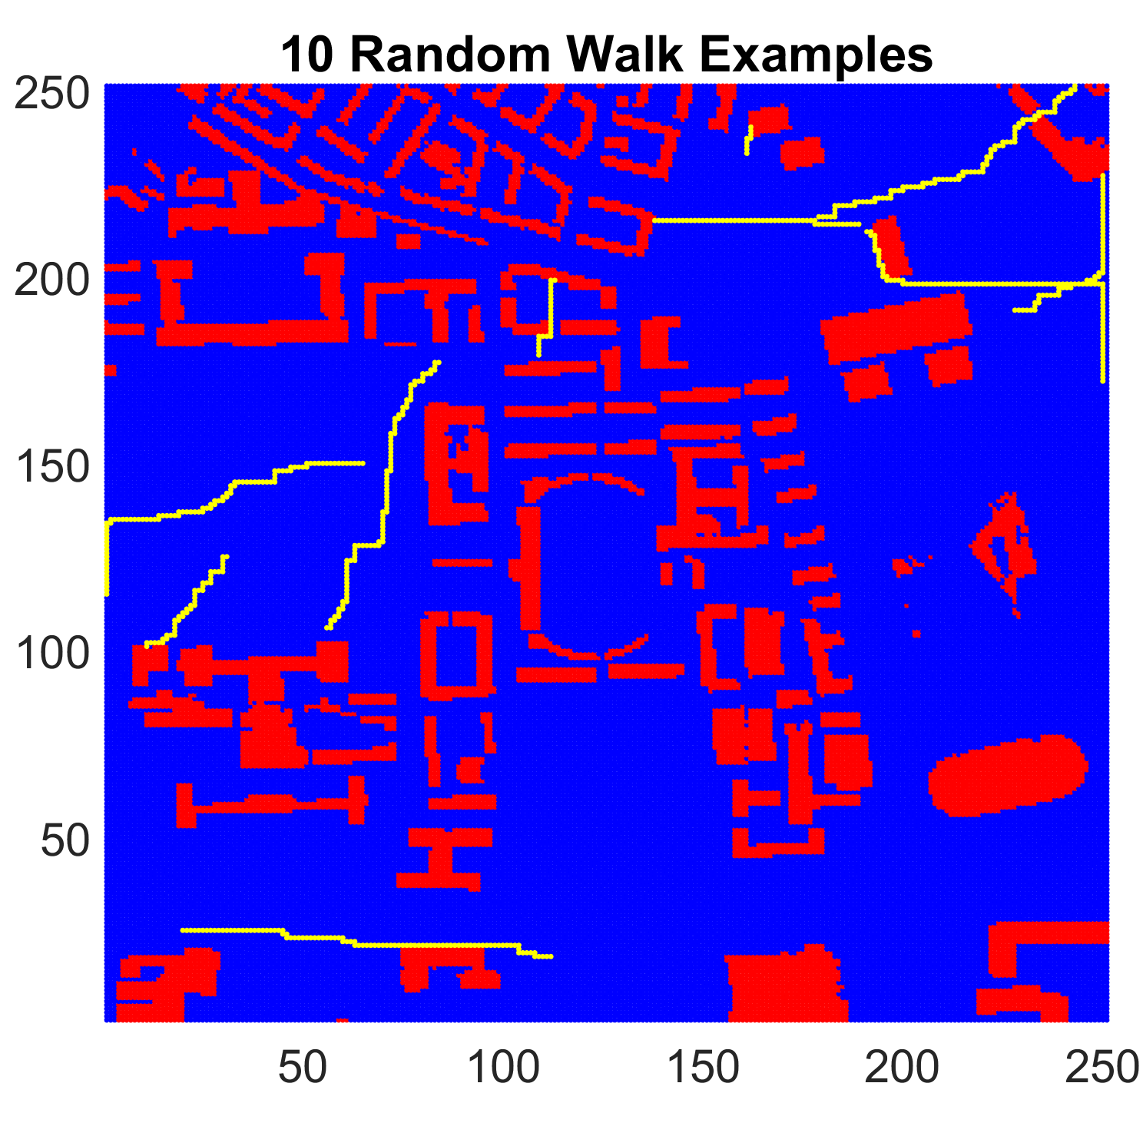
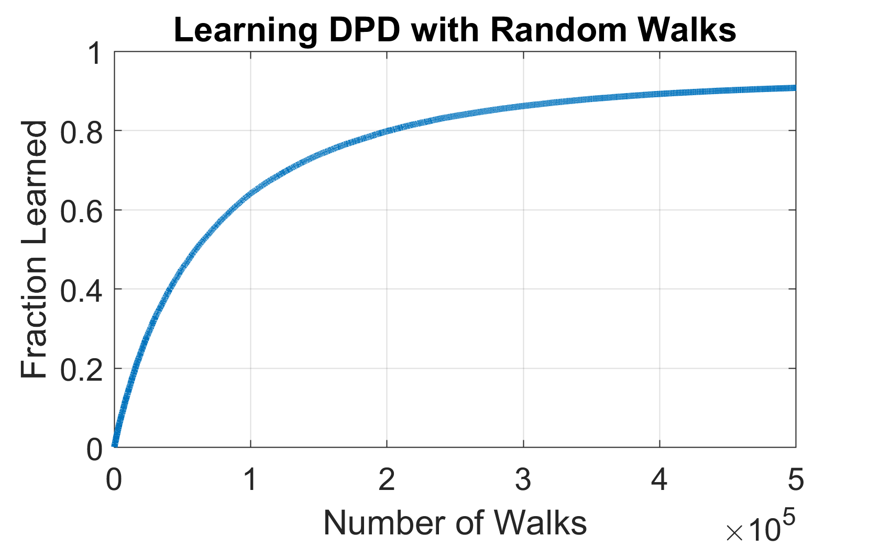
Random Walk Simulation Study
We simulated 500,000 such random paths.
It can be seen that over 90% of pairs can be learned with these paths.
Certain pairs cannot be learned if there is no path between them (for example, they are blocked by a building).
Notes:
We generated half a million of these paths and ran an analysis on how many of these discontinuous pairs we can find. It can be seen over 90% of pairs can be learned through these paths. Now half a million is a reasonable number, since in a city where millions of people are walking each day, these paths can easily be learned and analyzed for signal discontinuity. Now we have to acknowledge that certain pairs cannot be learned, for example of 2 points are blocked by a building then they will likely form a discontinuity pair, but our path may not be able to visit these points within10 steps. But fortunately, for the purpose of contact tracing, this is not that much of an issue, since if there is a wall separating the 2 individuals, it is unlikely the infection can spread from one person to another.

Slide 34
Applying the DPD
PCI … | 1 | 2 | 3 | …
1 | A1,B1 | A1,B2 | A1,B3 | …
2 | A2,B1 | A2,B2 | A2,B3 | …
3 | A3,B1 | A3,B2 | A3,B3 | …
… | … | … | … | …
The database is used by Vecsim to correct it’s estimate.
To optimize search time, the database is indexed in 3 dimensions.
The PCI identifier
The Tadv of the first MRO record
The Tadv of the second MRO record
PCI ID
PCI 2 | 1 | 2 | 3 | …
1 | A1,B1 | A1,B2 | A1,B3 | …
2 | A2,B1 | A2,B2 | A2,B3 | …
3 | A3,B1 | A3,B2 | A3,B3 | …
… | … | … | … | …
PCI 1 | 1 | 2 | 3 | …
1 | A1,B1 | A1,B2 | A1,B3 | …
2 | A2,B1 | A2,B2 | A2,B3 | …
3 | A3,B1 | A3,B2 | A3,B3 | …
… | … | … | … | …
Tadv of MRO 2
Tadv of MRO 1
Notes:
Finally we use indexing to optimize our search time and index our databased in 3 dimensions based on the PCI ID, the Tadv of the first MRO record and the Tadv of the second MRO record.

Slide 35
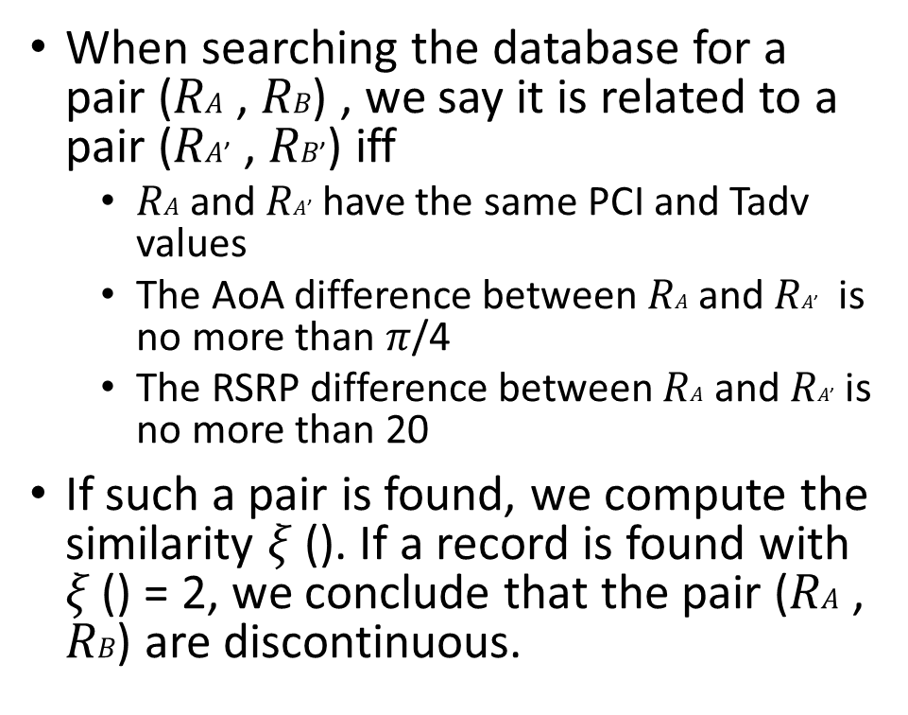
Applying the DPD
PCI … | 1 | 2 | 3 | …
1 | A1,B1 | A1,B2 | A1,B3 | …
2 | A2,B1 | A2,B2 | A2,B3 | …
3 | A3,B1 | A3,B2 | A3,B3 | …
… | … | … | … | …
When searching the database for a pair (𝑅𝐴 , 𝑅𝐵) , we say it is related to a pair (𝑅𝐴’ , 𝑅𝐵’) iff
𝑅𝐴 and 𝑅𝐴’ have the same PCI and Tadv values
The AoA difference between 𝑅𝐴 and 𝑅𝐴’ is no more than $π$/4
The RSRP difference between 𝑅𝐴 and 𝑅𝐴’ is no more than 20
If such a pair is found, we compute the similarity 𝜉 (). If a record is found with 𝜉 () = 2, we conclude that the pair (𝑅𝐴 , 𝑅𝐵) are discontinuous.
PCI ID
PCI 2 | 1 | 2 | 3 | …
1 | A1,B1 | A1,B2 | A1,B3 | …
2 | A2,B1 | A2,B2 | A2,B3 | …
3 | A3,B1 | A3,B2 | A3,B3 | …
… | … | … | … | …
PCI 1 | 1 | 2 | 3 | …
1 | A1,B1 | A1,B2 | A1,B3 | …
2 | A2,B1 | A2,B2 | A2,B3 | …
3 | A3,B1 | A3,B2 | A3,B3 | …
… | … | … | … | …
Tadv of MRO 2
Tadv of MRO 1
Notes:
So we make an additional adjustment in Vecsim, such that if the discrete estimate between 2 points is larger than 4, we do a lookup on our discontinuity pair database to check whether the 2 points area actually farther apart or they form a discontuity pair. If we find a pair ion our database, which similar to the pair in question, we conclude it is a discontinuous pair.

Slide 36
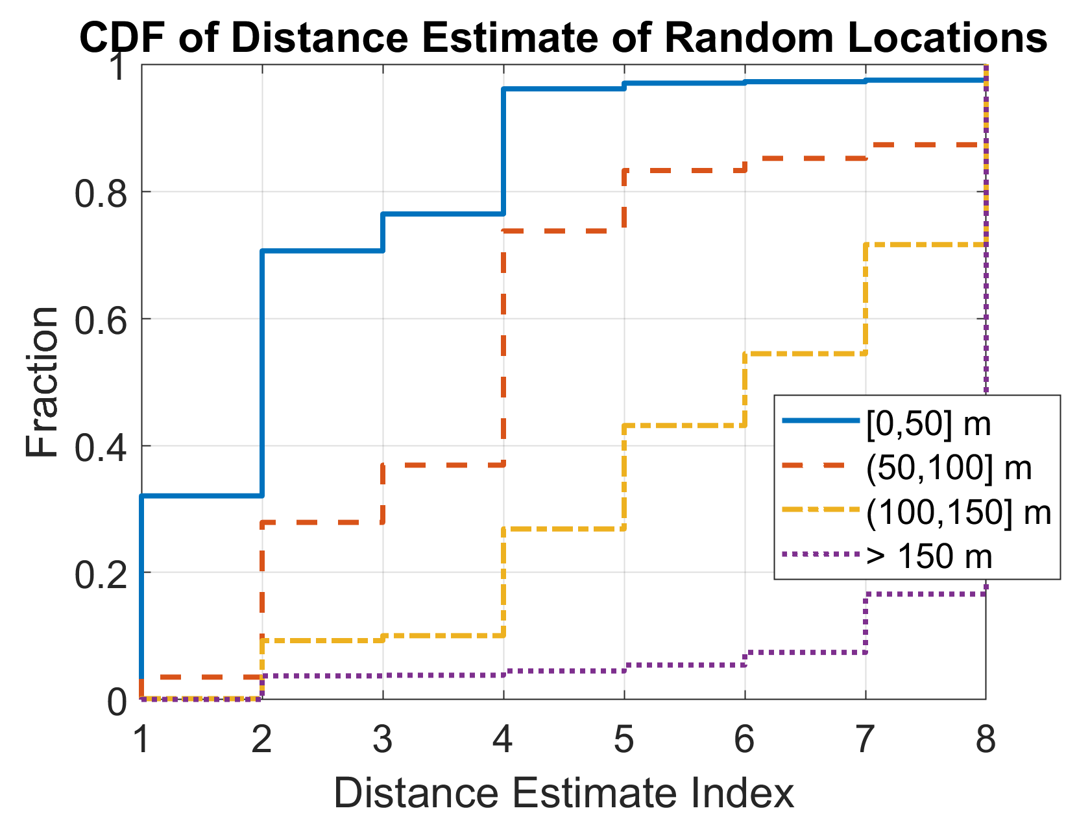
Evaluation – Estimation Accuracy
1000 locations were randomly selected in the study area.
Gaussian noise is added to the AoA and RSRP values in the MRO data for each location.
The distance estimate is calculated for every pair of locations connected to the same base station.
Vecsim will trigger an alert 96% of the time, when the pair of locations are close i.e with 50 meters of each other.
Further, it will only trigger an alert 4.5% of the time when the pairs are further than 150 m apart.
This accuracy is extremely satisfactory, considering Vecsim does not require road tests, GPS locations or any training.
Notes:
We did an extensive suite of evaluation tests with Vecsim. Our estimation accuracy which is one of the critical components of contact tracing is over 96% which is extremely impressive considering the fact that we do not require GPS locations, use involvement road tests or any kind of training. We also note that our false positive percentage is only about 4.5% which is an acceptable threshold in this kind of application. We ran our tests on 1000 random locations in our focus area and added some level of Gaussian noise to the Angle of Arrival and RSRP values in the MRO data to also test the robustness of Vecsim

Slide 37
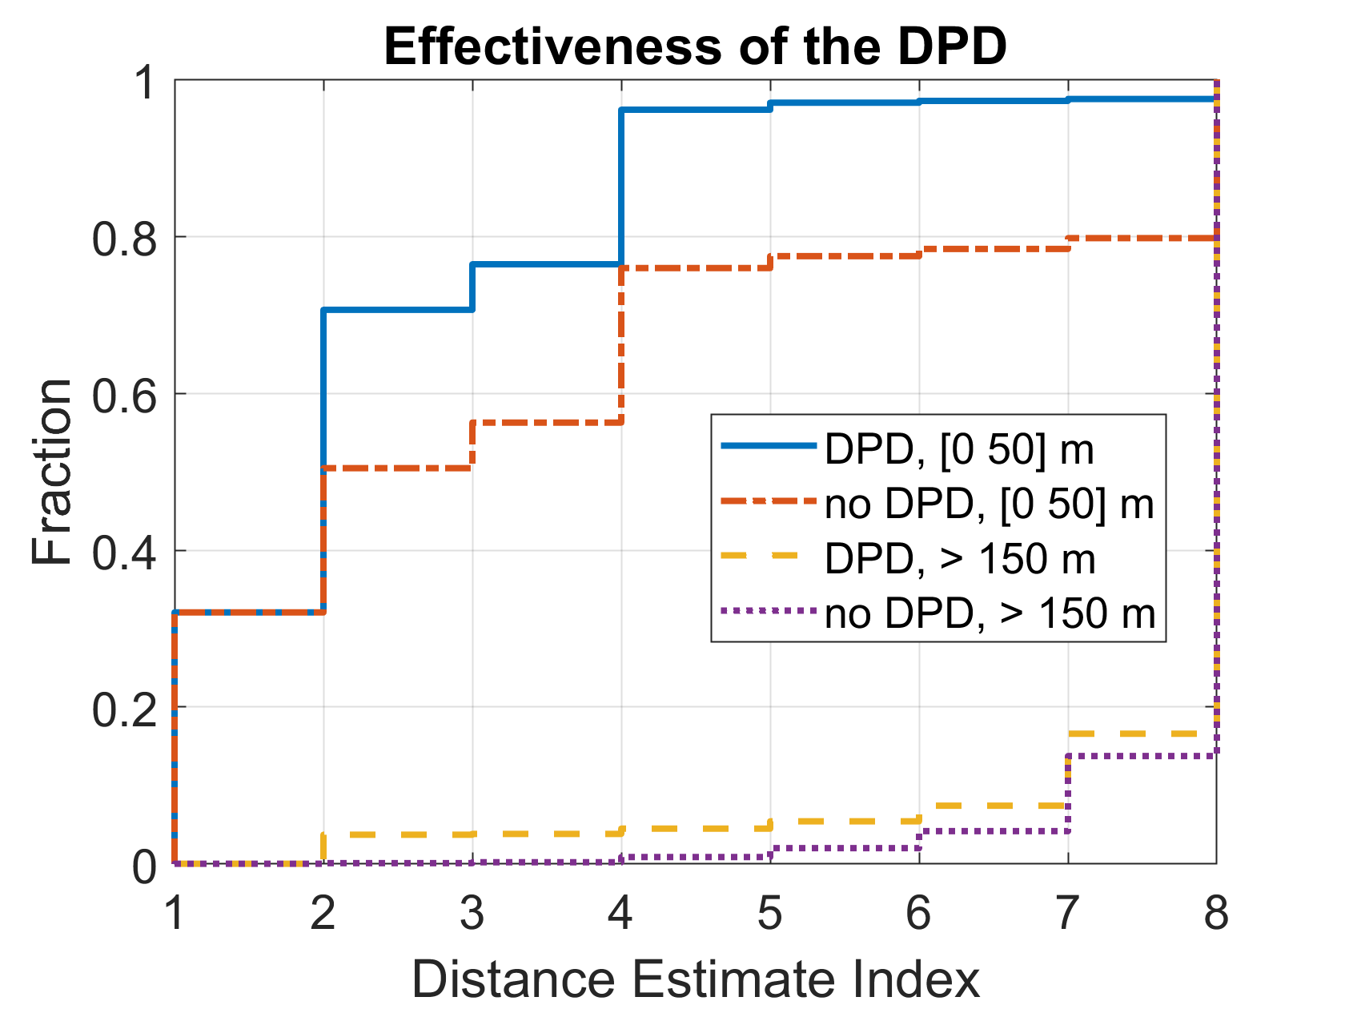
Evaluation - Effectiveness of DPD
DPD significantly improves performance.
Without DPD, the alert probability falls to 76% by simply using the distance estimate.
DPD only increases the false positive rate slightly from 0.01% to 4.5%
Notes:
In addition to the estimation accuracy, we also test the effectiveness of using our discontinuous pair database. We found that without using the database our alert probability fell to 76% by only using the discrete distance estimate.

Slide 38

Evaluation – Complexity of DPD
Main complexity arises when doing a linear scan to look up similar pairs in the DPD.
Complexity is lowered by using the indexing along the Tadv and PCI values.
It is also lowered by compressing the database, thereby reducing the number of comparisons with entries.
Overall the median number of comparisons is only 2.
Notes:
We also checked the complexity of lookups using our discontinuous pair database. The main complexity arises when linearly scanning for similar pairs in the discontinuous pair database. We lowered the complexity by indexing our database along the Tadv and PCI values. Overall it can be seen that by compressing the database and indexing it, the median number of comparisons is only 2.

Slide 39

Evaluation – Compression of DPD
There is virtually no loss in performance of estimation accuracy when using the non-compressed DPD vs compressed DPD
Notes:
Since we compress our database, we also ran a test to see what the performance penalty was when using a compressed database vs an uncompressed database which logs all discontinuous pairs. We found there was virtually no loss in estimation accuracy when using the compressed version of DPD.

Slide 40


Evaluation – Sensitivity to Noise
Vecism is highly robust to noise
2 tests were run
The first tests Vecsim by adding varying levels of noise to AoA.
The AoA starts affecting performance only when the noise standard deviation reaches 0.1
The second tests Vecsim by adding varying levels of noise to the RSRP.
The alert probability is affected only when the noise standard deviation is 15 or greater.
Notes:
Finally we checked how robust Vecsim was to varying noise level to the Angle of Arrival and the RSRP. We found that Vecsim was highly robust to noise, and the alert probability was affected only when the noise standard deviation reaches 0.1 for the AoA and greater than 15 for the RSRP

Slide 41
Conclusion
Vecism is a highly effective contact tracing method that preserves user privacy.
Alerts more than 96% of users in close proximity (50 m or less) by simply looking at their MRO records which is collected by all carriers.
Alerts less than 4.5% users when they are further than 150 m apart.
The performance will further improve as more data is logged as more discontinuity pairs are discovered.
Finally it has a negligible financial cost to implement.
Notes:
In conclusion, we proposed Vecsim a highly effective contact tracing solution that preserves user privacy. Vecsim enjoy an alert probalbity of 96% while maintaining a low fasle positive rate of under 4.5%. We note that as more data is logged by the carriers, the performance is Vecsim is likely to improve, as more discontinuous paris are discovered. Finally Vecism does not require any additional ifrastucture or user involvement and has a negligible financial cost to implement
Thank You!

Slide 42
Thank You!

